Slide 1
Calendar Gold Signal
Strategy - 1
Risk Management :
Daily Risk: 1.5% of the capital.
Total Loss Per Trade: $15 (1.5% of $1000)
Reward Management :
Daily Reward : 2.5% of the capital.
Total Profit Per Trade : $25 (2.5% of Capital)
4
FOCAL SERVICE
1
Level 1 with 2 entries.
5
Trade Frequency : Only one signal per 24 hours.
2
6
Capital Investment : Minimum $1000
Order Execution Time: 5 minutes
3
7
Lot Size: 0.01
Accuracy: 90%

Slide 2
Example Trade Setup
Instrument : BUY XAUUSD
Level 1 : 2380-2375
Entry 1 : 2380
Entry 2 : 2375
Stop Loss (SL) : 2370
Take Profit (TP) : 2390
Risk to Reward Ratio : 1/1.5
Trading Lot Size : 0.01
Level | Number of Entries | Level Entry | SL | TP | Risk | Reward
1 | Entry 1 | 2380 | 2370 | 2390 | $10 | $10
1 | Entry 2 | 2375 | 2370 | 2390 | $5 | $15
Total Risk/ Reward | Total Risk/ Reward | Total Risk/ Reward | Total Risk/ Reward | Total Risk/ Reward | $15 | $25

Slide 3
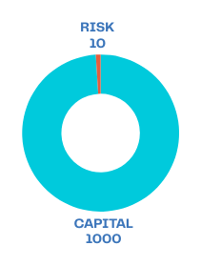
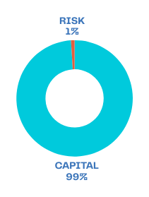
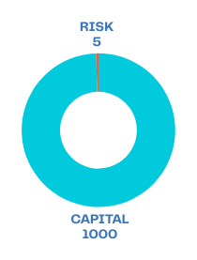
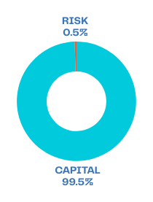
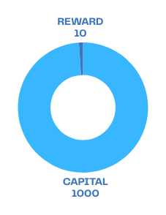
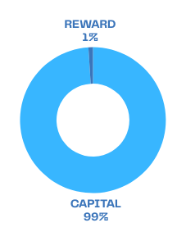
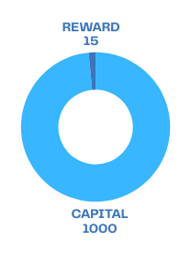
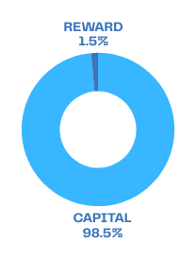
Entry 1 Calculation:
Entry 2 Calculation:
Entry Price : 2380
Stop Loss : 2370
TP : 2390
Total Risk
- Entry 1 - SL point
- 2380 − 2370 = 10 points
1% Risk on $1000 capital
Risk from Entry 1 : $10
Entry Price : 2375
Stop Loss : 2370
TP : 2390
Total Risk
- Entry 2 - SL point
- 2375 − 2370 = 5 points
0.5% Risk on $1000 capital
Risk from Entry 1 : $5
$
$
$
$
---------------------------------
---------------------------------
-------------------------------------
$
Total Reward :
Profit per lot (0.01) from Entry 1:
= TP point - Entry 1
2390 − 2380 = 10 points
1% Reward on $1000 capital
Reward = 1000 * 1%= $10
$
Total Reward :
Profit per lot (0.01) from Entry 2:
= TP point - Entry 2
2390 − 2375 = 15 points
1.5 % Reward on $1000 capital
Reward = 1000 * 1.5% = $15
$
$

Slide 4
PREMIUM SERVICE
Risk Management :
Daily Risk: 3.0% of the capital.
Total Loss Per Trade: $300 (3.0% of Capital)
Reward Management :
Daily Reward : 8.0% of the capital.
Total Profit Per Trade : $800 (8.0% of Capital)
4
1
Level -1 & Level -2
5
No overnight holding
2
6
Instant/Pending Orders
Capital Investment : Minimum $10k
3
7
Lot Size: 0.10
Accuracy : 97%

Slide 5
Example Trade Setup
Instrument : BUY XAUUSD
Level 1 : 2380-2375 | SL - 2370
Entry 1 : 2380
Entry 2 : 2375
Stop Loss (SL 1) : 2370
Take Profit (TP) : 2390
Risk and Reward Analysis
Risk to Reward Ratio : 1/1.5
Trading Lot Size : 0.10
Level 2 : 2365-2360 | SL - 2355
Entry 3 : 2365
Entry 4 : 2360
Stop Loss (SL 2) : 2355
Take Profit (TP) : 2390
Risk and Reward Analysis
Risk to Reward Ratio : 1/3.0
Trading Lot Size : 0.10
level | Number of Entries | Level Entry | SL | TP | Risk | Reward
1 | Entry 1 | 2380 | 2370 | 2390 | $100 | $100
1 | Entry 2 | 2375 | 2370 | 2390 | $50 | $150
2 | Entry 1 | 2365 | 2355 | 2390 | $100 | $250
2 | Entry 2 | 2360 | 2355 | 2390 | $50 | $300
Total Risk/ Reward | Total Risk/ Reward | Total Risk/ Reward | Total Risk/ Reward | Total Risk/ Reward | $300 | $800

Slide 6
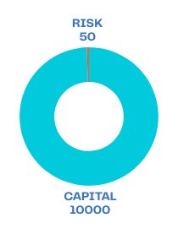
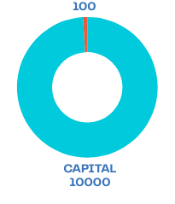
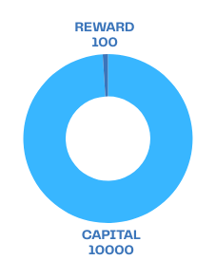
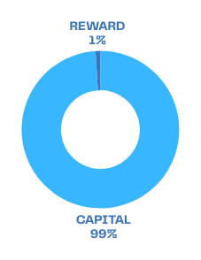
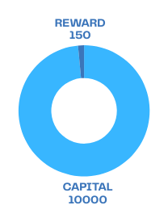
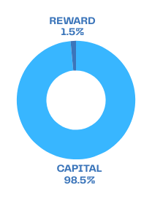
Level 1 Calculation:
Entry 1 Calculation:
Entry 2 Calculation:
Entry Price : 2380
Stop Loss : 2370
TP : 2390
Total Risk
- Entry 1 - SL point
- 2380 − 2370 = 10 points
1% Risk on $10000 capital
Risk from Entry 1 : $100
Entry Price : 2375
Stop Loss : 2370
TP : 2390
Total Risk
- Entry 2 - SL point
- 2375 − 2370 = 5 points
0.5% Risk on $10000 capital
Risk from Entry 1 : $50
$
$
$
$
---------------------------------
---------------------------------
-------------------------------------
$
Total Reward :
Profit per lot (0.10) from Entry 1:
= TP point - Entry 1
2390 − 2380 = 10 points
1% Reward on $10000 capital
Reward = $10000 * 1% = $100
$
Total Reward :
Profit per lot (0.10) from Entry 2:
= TP point - Entry 2
2390 − 2375 = 15 points
1.5 % Reward on $10000 capital
Reward = $10000 * 1.5% = $150
$
$

Slide 7
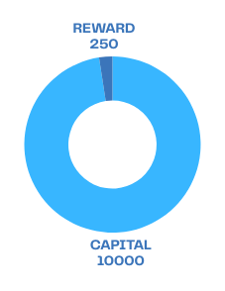
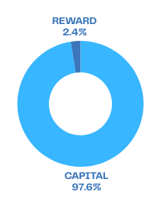
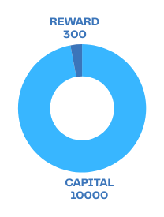
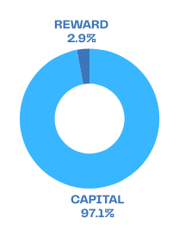
Level 2 Calculation:
Entry 3 Calculation:
Entry 4 Calculation:
Entry Price : 2365
Stop Loss : 2355
TP : 2390
Total Risk
- Entry 3 - SL point
- 2365 - 2355 = 10 points
1% Risk on $10000 capital
Risk from Entry 3 : $100
Entry Price : 2360
Stop Loss : 2355
TP : 2390
Total Risk
- Entry 4 - SL point
- 2360 - 2355 = 5 points
0.5% Risk on $10000 capital
Risk from Entry 4 : $50
$
$
$
$
---------------------------------
---------------------------------
-------------------------------------
$
Total Reward :
Profit per lot (0.10) from Entry 3:
= TP point - Entry 3
2390 − 2365 = 25 points
2.5% Reward on $10000 capital
Reward = $10000 * 2.5%= $250
$
Total Reward :
Profit per lot (0.10) from Entry 4:
= TP point - Entry 4
2390 − 2360 = 30 points
3.0% Reward on $10000 capital
Reward = $10000 * 3.0% = $300
$
$

Slide 8
PLATINUM SERVICE
Risk Management :
Daily Risk : 4.5% of the capital.
Total Loss Per Trade : $4500 (4.5% of Capital)
Reward Management :
Daily Reward : 16.5% of the capital.
Total Profit Per Trade : $16,500 (16.5% of Capital)
4
1
Multiple entries for the trade.
5
No overnight holding
2
Capital Investment : Minimum $100k
6
Instant/Pending Orders
3
Lot Size : 1.0
7
Accuracy : 99%

Slide 9
Instrument : BUY XAUUSD
Example Trade Setup
Level 1 : 2380-2375 | SL - 2370
Entry 1 : 2380
Entry 2 : 2375
Stop Loss (SL 1) : 2370
Take Profit (TP) : 2390
Risk and Reward Analysis
Risk to Reward Ratio : 1/1.5
Trading Lot Size : 1.0
Level 2 : 2365-2360 | SL - 2355
Entry 3 : 2365
Entry 4 : 2360
Stop Loss (SL 2) : 2355
Take Profit (TP) : 2390
Risk and Reward Analysis
Risk to Reward Ratio : 1/3.0
Trading Lot Size : 1.0
Level 3 : 2350-2345 | SL - 2340
Entry 3 : 2350
Entry 4 : 2345
Stop Loss (SL 3) : 2340
Take Profit (TP) : 2390
Risk and Reward Analysis
Risk to Reward Ratio : 1/4.5
Trading Lot Size : 1.0
level | Number of Entries | Level Entry | SL | TP | Risk | Reward
1 | Entry 1 | 2380 | 2370 | 2390 | $1000 | $1000
1 | Entry 2 | 2375 | 2370 | 2390 | $500 | $1500
2 | Entry 1 | 2365 | 2355 | 2390 | $1000 | $2500
2 | Entry 2 | 2360 | 2355 | 2390 | $500 | $3000
3 | Entry 1 | 2350 | 2340 | 2390 | $1000 | $4000
3 | Entry 2 | 2345 | 2340 | 2390 | $500 | $4500
Total Risk/ Reward | Total Risk/ Reward | Total Risk/ Reward | Total Risk/ Reward | Total Risk/ Reward | $4500 | $16,500

Slide 10
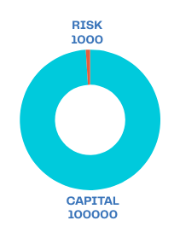
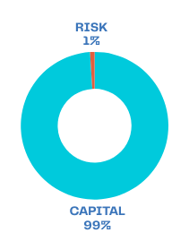
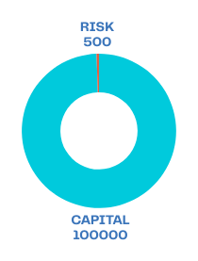
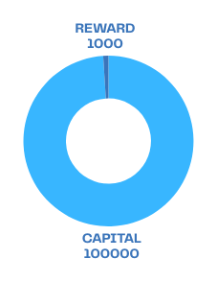
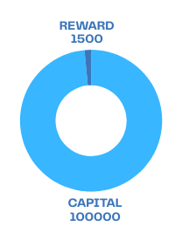
Level 1 Calculation:
Entry 1 Calculation:
Entry 2 Calculation:
Entry Price : 2380
Stop Loss : 2370
TP : 2390
Total Risk
- Entry 1 - SL point
- 2380 − 2370 = 10 points
1% Risk on $100k capital
Risk from Entry 1 : $1000
Entry Price : 2375
Stop Loss : 2370
TP : 2390
Total Risk
- Entry 2 - SL point
- 2375 − 2370 = 5 points
0.5% Risk on $100k capital
Risk from Entry 1 : $500
$
$
$
$
---------------------------------
---------------------------------
-------------------------------------
$
Total Reward :
Profit per lot (1.0) from Entry 1:
= TP point - Entry 1
2390 − 2380 = 10 points
1% Reward on $100k capital
Reward = 100k * 1% = $1000
$
Total Reward :
Profit per lot (1.0) from Entry 2:
= TP point - Entry 2
2390 − 2375 = 15 points
1.5% Reward on $100k capital
Reward = $100k * 1.5% = $1500
$
$

Slide 11
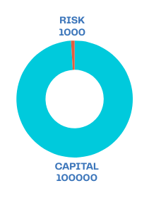
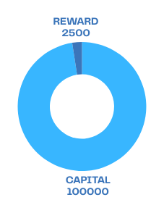
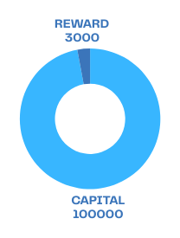
Level 2 Calculation:
Entry 3 Calculation:
Entry 4 Calculation:
Entry Price : 2365
Stop Loss : 2355
TP : 2390
Total Risk
- Entry 1 - SL point
- 2365 - 2355 = 10 points
1% Risk on $100k capital
Risk from Entry 1 : $1000
Entry Price : 2360
Stop Loss : 2355
TP : 2390
Total Risk
- Entry 2 - SL point
- 2360 - 2355 = 5 points
0.5% Risk on $100k capital
Risk from Entry 1 : $500
$
$
$
---------------------------------
---------------------------------
-------------------------------------
$
Total Reward :
Profit per lot (1.0) from Entry 3:
= TP point - Entry 3
2390 − 2365 = 25 points
2.5% Reward on $100k capital
Reward = $100k * 2.5%= $2500
$
Total Reward :
Profit per lot (1.0) from Entry 4:
= TP point - Entry 4
2390 − 2360 = 30 points
3.0% Reward on $100k capital
Reward = $100k * 3.0% = $3000
$
$

Slide 12
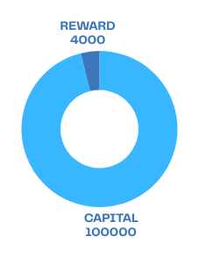
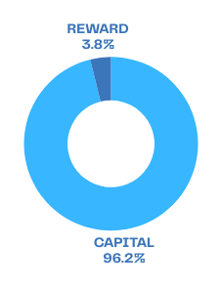
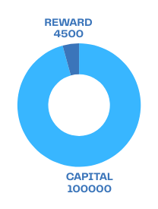
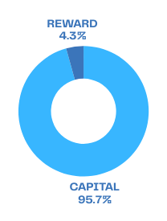
Level 3 Calculation:
Entry 5 Calculation:
Entry 6 Calculation:
Entry Price : 2350
Stop Loss : 2340
TP : 2390
Total Risk
- Entry 5 - SL point
- 2350 - 2345 = 10 points
1% Risk on $100k capital
Risk from Entry 5 : $1000
Entry Price : 2345
Stop Loss : 2340
TP : 2390
Total Risk
- Entry 6 - SL point
- 2345 - 2340 = 5 points
0.5% Risk on $100k capital
Risk from Entry 6 : $500
$
$
$
---------------------------------
---------------------------------
-------------------------------------
$
Total Reward :
Profit per lot (1.0) from Entry 5:
= TP point - Entry 5
2390 − 2350 = 40 points
4% Reward on $100k capital
Reward = $100k * 4%= $4000
$
Total Reward :
Profit per lot (1.0) from Entry 6:
= TP point - Entry 6
2390 − 2345 = 45 points
4.5% Reward on $100k capital
Reward = $100k * 4.5% = $4500
$
$

Slide 13
CONCLUTION
FOCAL SERVICE
PREMIUM SERVICE
PLATINUM SERVICE
Trading lot size : 0.01 lot
Capital = 1000
Risk to Reward Ratio : 1/1.5
Daily loss : $15
Daily profit : $25
Accuracy : 90%
Trading days : 22
Monthly risk 10%
$15 * 3 days = $45
Monthly reward 90%
$25 * 19 days = $475
Trading lot size : 0.10 lot
Capital = 10k
Risk to Reward Ratio : 1/1.5
Daily loss : $300
Daily profit : $800
Accuracy : 97%
Trading days : 22
Monthly risk 3%
$300 * 2 days = $600
Monthly reward 97%
$800* 20= $16,000
Trading lot size : 1.0 lot
Capital = 100k
Risk to Reward Ratio : 1/1.5
Daily loss : $4500
Daily profit : $16500
Accuracy : 99%
Trading days : 22
Monthly risk 1%
$4500 * 1 days = $4500
Monthly reward 99%
$16500* 21 = $346,500

