Slide 1

Calendar Gold Signal
Strategy - 2
Risk Management :
    Daily Risk: 5.4% per trade.
    Total Loss Per Trade : $54 (5.4% of capital)
Reward Management :
    Daily Reward : 12.6% per trade.
    Total Profit Per Trade : $126 (12.6% of capital)
FOCAL SERVICE
5
1
Level 1 with 2 entries.
2
6
Trade Frequency : Only one signal per 24 hours.
Capital Investment : Minimum $1000
3
7
Lot Size: 0.01
Order Execution Time : 1 minute
4
8
Trading tool will be given to place the order
Accuracy: 90%

Slide 2
Instrument : BUY XAUUSD
Number of Entries | Level | SL | TP | Lot size | Risk | Reward
Entry 1 | 2380 | 2370 | 2390 | 0.01 | $10 | $10
Entry 2 | 2379 | 2370 | 2390 | 0.01 | $9 | $11
Entry 3 | 2378 | 2370 | 2390 | 0.01 | $8 | $12
Entry 4 | 2377 | 2370 | 2390 | 0.01 | $7 | $13
Breakeven point : 2376.5 (No profit no loss point) | Breakeven point : 2376.5 (No profit no loss point) | Breakeven point : 2376.5 (No profit no loss point) | Breakeven point : 2376.5 (No profit no loss point) | Breakeven point : 2376.5 (No profit no loss point) | Breakeven point : 2376.5 (No profit no loss point) | Breakeven point : 2376.5 (No profit no loss point)
Entry 5 | 2376 | 2370 | 2390 | 0.01 | $6 | $14
Entry 6 | 2375 | 2370 | 2390 | 0.01 | $5 | $15
Entry 7 | 2374 | 2370 | 2390 | 0.01 | $4 | $16
Entry 8 | 2373 | 2370 | 2390 | 0.01 | $3 | $17
Entry 9 | 2372 | 2370 | 2390 | 0.01 | $2 | $18
Total Risk/ Reward |  |  |  | 0.09 Lot | $54 | $126
Level 1 : 2380-2375 | SL - 2370
Entry 1 : 2380
Entry 2 : 2379
Entry 3 : 2378
Entry 4 : 2377
Entry 5 : 2376
Entry 6 : 2375
Entry 7 : 2374
Entry 8 : 2373
Entry 9 : 2372
Breakeven point : 2376.5
Stop Loss (SL) : 2370
Take Profit (TP) : 2390
Risk and Reward Analysis
Risk to Reward Ratio : 5.4/12.6
Capital : $1000
Trading Lot Size : 0.01/entry
RISK FORMULA :
=Entry - SL = $__ Profit
RISK = $__ Profit * 100 / CAPITAL
REWARD FORMULA :
=Entry - TP = $__Profit
Reward = $__Profit * 100 / Capital

Slide 3
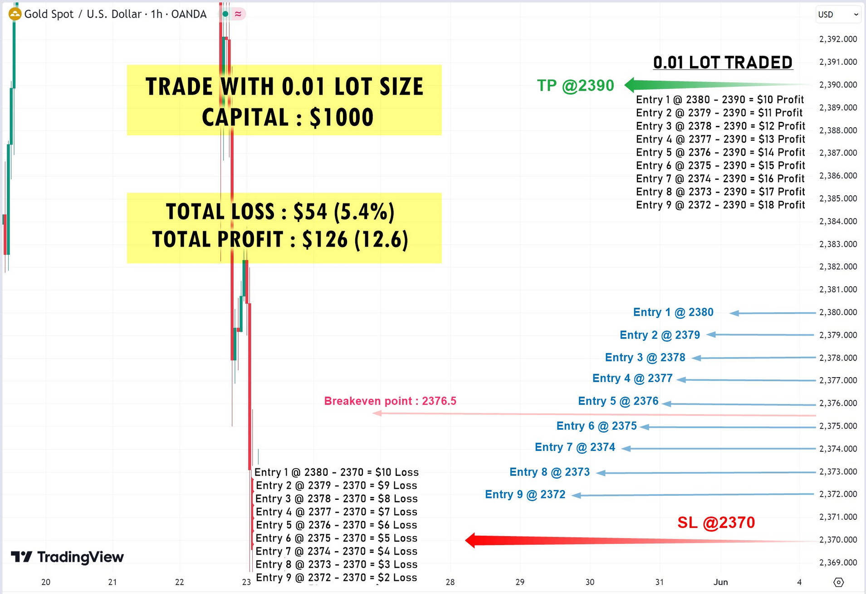


Slide 4
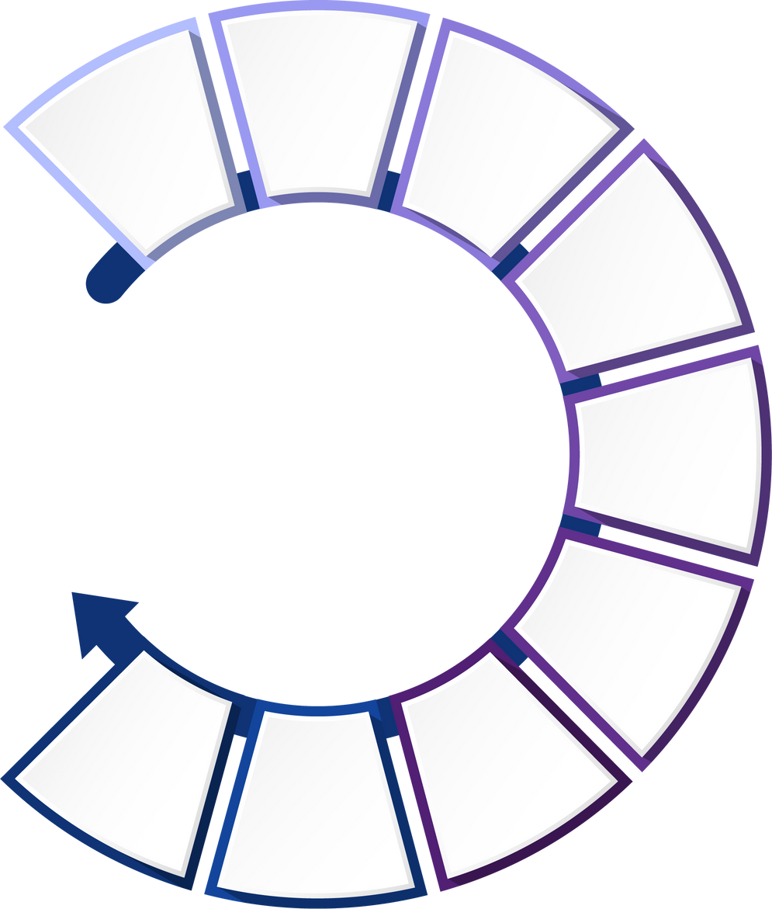
0.01 LOT TRADED
RISK CALCULATION
REWARD CALCULATION
Entry 2 @ 2379 - 2370 = $9 Loss
Entry 2 @ 2390 - 2379 = $11 Profit
Entry 1 @ 2380 - 2370 = $10 Loss
Entry 3 @ 2378 - 2370
= $8 Loss
Entry 3 @ 2390 - 2378
= $12 Profit
Entry 1 @ 2390 - 2380 = $10 Profit
Entry 4 @ 2377 - 2370
= $7 Loss
Entry 4 @ 2390 - 2377 = $13 Profit
SL @ 2370
Total $54 Loss
ROI = 5.4%
TP @ 2390
Total $126 Profit
ROI = 12.6%
Entry 5 @ 2376 - 2370 = $6 Loss
Entry 5 @ 2390 - 2376
= $14 Profit
Entry 6 @ 2375 - 2370 = $5 Loss
Entry 6 @ 2390 - 2375 = $15 Profit
Entry 9 @ 2372 - 2370 = $2 Loss
Entry 7 @ 2374 - 2370 = $4 Loss
Entry 7 @ 2390 - 2374 = $16 Profit
Entry 9 @ 2390 - 2372 = $18 Profit
Entry 8 @ 2373 - 2370 = $3 Loss
Entry 8 @ 2390 - 2373 = $17 Profit

Slide 6
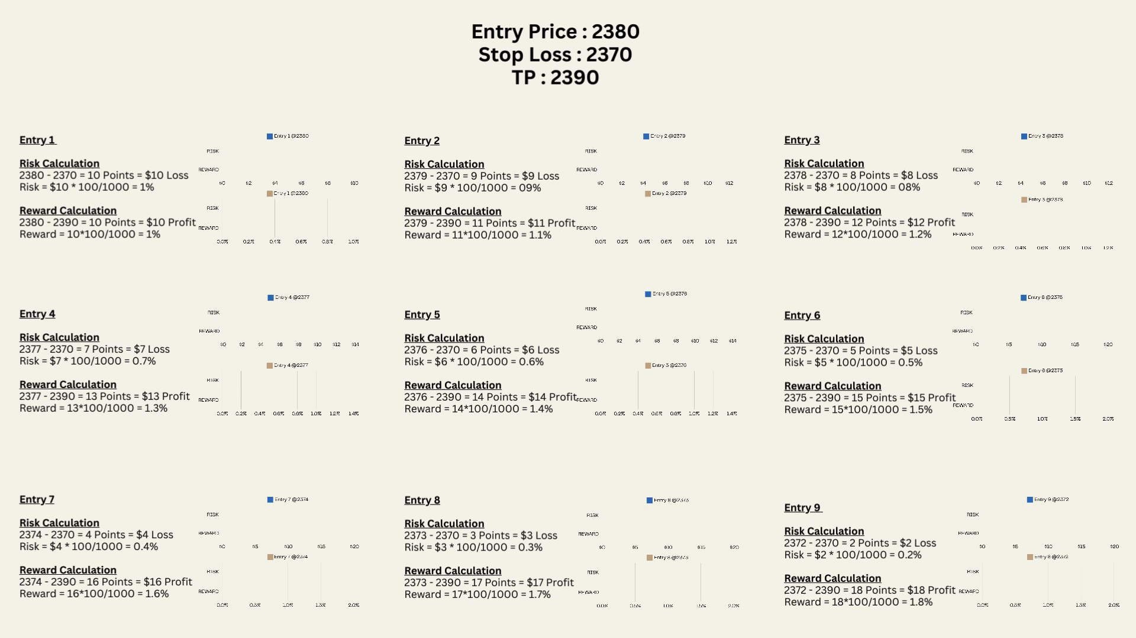

Slide 7
PREMIUM SERVICE
Risk Management :
    Daily Risk: 10% of the capital.
Reward Management :
    Daily Reward : 39% of the capital.
5
1
Level -1 & Level -2
6
No overnight holding
2
Capital Investment : Minimum $10k
7
Instant/Pending Orders
3
Lot Size: 0.10
4
8
Trading tool will be given to place the order
Accuracy : 97%

Slide 8
Number of Entries | Level | SL | TP | Lot size | Risk | Reward
Entry 1 | 2380 | 2370 | 2390 | 0.10 | $100 | $100
Entry 2 | 2379 | 2370 | 2390 | 0.10 | $90 | $110
Entry 3 | 2378 | 2370 | 2390 | 0.10 | $80 | $120
Entry 4 | 2377 | 2370 | 2390 | 0.10 | $70 | $130
Breakeven point : 2376.5 (No profit no loss point) | Breakeven point : 2376.5 (No profit no loss point) | Breakeven point : 2376.5 (No profit no loss point) | Breakeven point : 2376.5 (No profit no loss point) | Breakeven point : 2376.5 (No profit no loss point) | Breakeven point : 2376.5 (No profit no loss point) | Breakeven point : 2376.5 (No profit no loss point)
Entry 5 | 2376 | 2370 | 2390 | 0.10 | $60 | $140
Entry 6 | 2375 | 2370 | 2390 | 0.10 | $50 | $150
Entry 7 | 2374 | 2370 | 2390 | 0.10 | $40 | $160
Entry 8 | 2373 | 2370 | 2390 | 0.10 | $30 | $170
Entry 9 | 2372 | 2370 | 2390 | 0.10 | $20 | $180
Total Risk/ Reward |  |  |  | 0.90 Lot | $540 | $1260
Instrument : BUY XAUUSD
Level 1 : 2380-2375 | SL - 2370
Entry 1 : 2380
Entry 2 : 2379
Entry 3 : 2378
Entry 4 : 2377
Entry 5 : 2376
Entry 6 : 2375
Entry 7 : 2374
Entry 8 : 2373
Entry 9 : 2372
Breakeven point : 2376.5
Stop Loss (SL) : 2370
Take Profit (TP) : 2390
Risk and Reward Analysis
Risk to Reward Ratio : 5.4/12.6
Capital : $10k
Trading Lot Size : 0.10/entry
REWARD FORMULA :
=Entry - TP = $__Profit
Reward = $__Profit * 100 / Capital

Slide 9
Number of Entries | Level | SL | TP | Lot size | Risk | Reward
Entry 10 | 2365 | 2355 | 2390 | 0.10 | $100 | $250
Entry 11 | 2364 | 2355 | 2390 | 0.10 | $90 | $260
Entry 12 | 2363 | 2355 | 2390 | 0.10 | $80 | $270
Entry 13 | 2362 | 2355 | 2390 | 0.10 | $70 | $280
Entry 14 | 2361 | 2355 | 2390 | 0.10 | $60 | $290
Entry 15 | 2360 | 2355 | 2390 | 0.10 | $50 | $300
Entry 16 | 2359 | 2355 | 2390 | 0.10 | $40 | $310
Entry 17 | 2358 | 2355 | 2390 | 0.10 | $30 | $320
Entry 18 | 2357 | 2355 | 2390 | 0.10 | $20 | $330
Total Risk/ Reward |  |  |  | 0.90 Lot | $540 | $2610
Level 2 : 2365-2360 | SL - 2355
Entry 10 : 2365
Entry 11 : 2364
Entry 12 : 2363
Entry 13 : 2362
Entry 14 : 2361
Entry 15 : 2360
Entry 16 : 2359
Entry 17 : 2358
Entry 18 : 2357
Stop Loss (SL) : 2355
Take Profit (TP) : 2390
Risk and Reward Analysis
Risk to Reward Ratio : 5.4/26.1
Capital : $10k
Trading Lot Size : 0.10
level 1 + level 2 Risk
= $540 + $540 = $1080
level 1 + level 2 Reward
= $1260 + $2610 = $3870

Slide 10
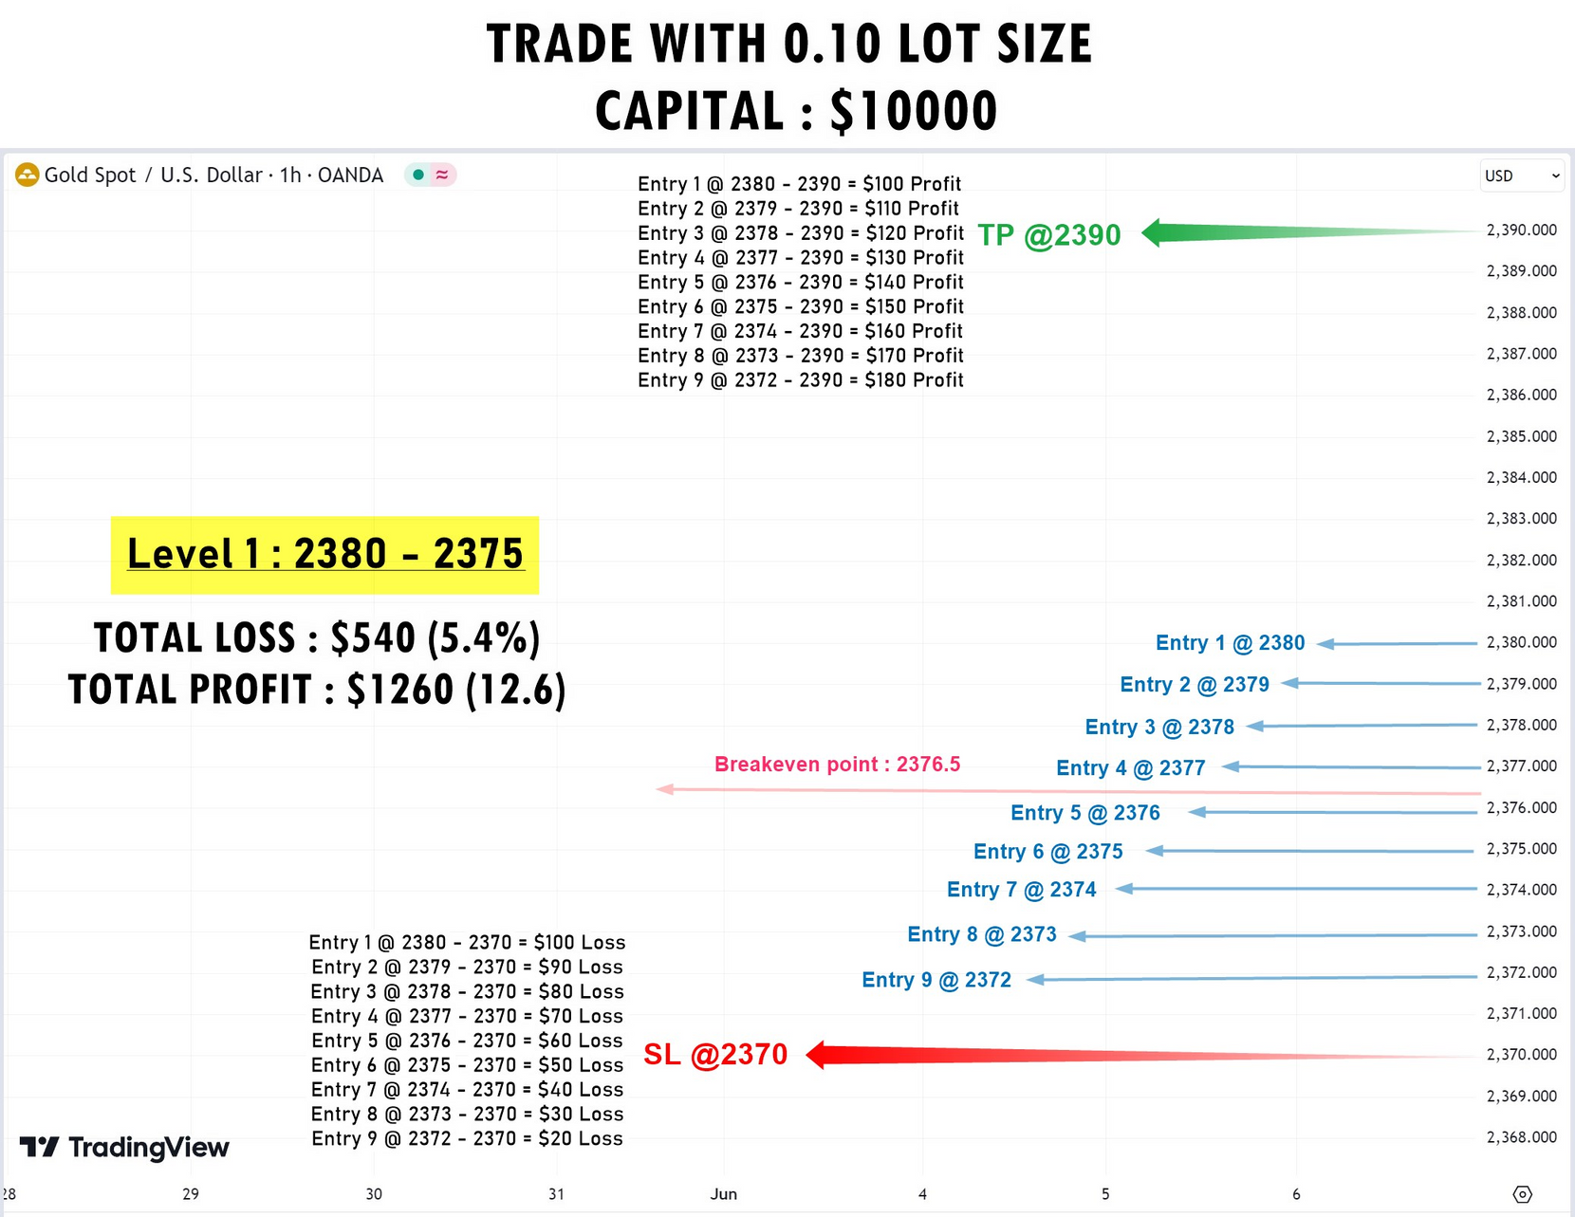

Slide 11
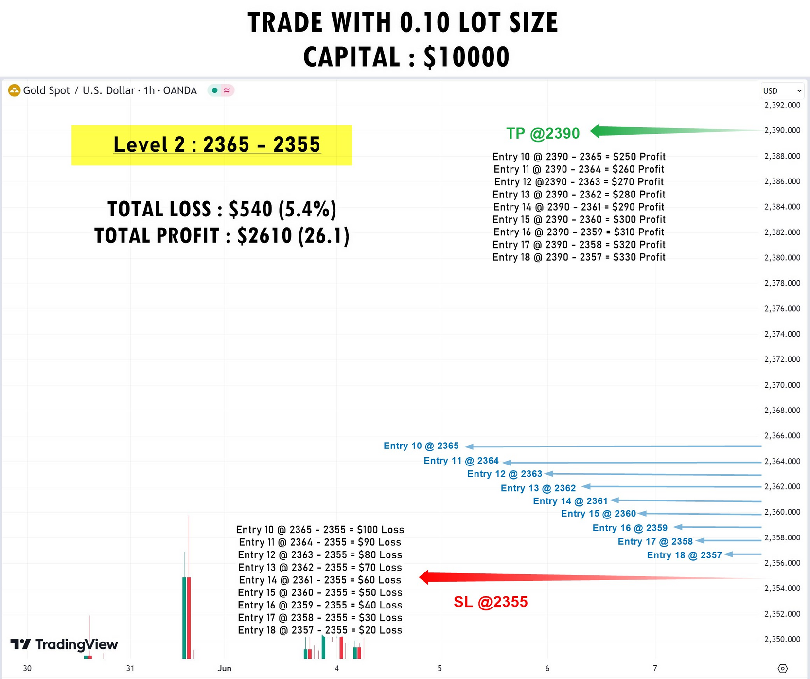

Slide 12
0.10 LOT TRADED
RISK CALCULATION
Level 1 : 2380-2375 | SL - 2370
Level 2 : 2365-2360 | SL - 2355
Entry 11 @ 2364 - 2355 = $90 Loss
Entry 2 @ 2379 - 2370 = $90 Loss
Entry 1 @ 2380 - 2370 = $100 Loss
Entry 3 @ 2378 - 2370
= $80 Loss
Entry 10 @ 2365 - 2355 = $100 Loss
Entry 12 @ 2363 - 2355
= $80 Loss
Entry 4 @ 2377 - 2370
= $70 Loss
Entry 13 @ 2362 - 2355
= $70 Loss
SL @ 2370
$540 Loss (Level 1)
ROI = 5.4%
SL @ 2355
$540 Loss (Level 2)
ROI = 5.4%
TOTAL $1080 LOSS
Entry 5 @ 2376 - 2370 = $60 Loss
Entry 14 @ 2361 - 2355 = $60 Loss
Entry 6 @ 2375 - 2370 = $50 Loss
Entry 15 @ 2360 - 2355 = $50 Loss
Entry 9 @ 2372 - 2370 = $20 Loss
Entry 7 @ 2374 - 2370 = $40 Loss
Entry 18 @ 2357 - 2355 = $20 Loss
Entry 16 @ 2359 - 2355 = $40 Loss
Entry 8 @ 2373 - 2370 = $30 Loss
Entry 17 @ 2358 - 2355 = $30 Loss
RISK FORMULA :
=Entry - SL = $__ Profit
RISK = $__ Profit * 100 / CAPITAL

Slide 13
0.10 LOT TRADED
REWARD CALCULATION
LEVEL - 1
LEVEL -2
Entry 2 @ 2390 - 2379 = $110 Profit
Entry 11 @ 2390 - 2364 = $260 Profit
Entry 3 @ 2390 - 2378
= $120 Profit
Entry 1 @ 2390 - 2380 = $100 Profit
Entry 12 @ 2390 - 2363
= $270 Profit
Entry 10 @ 2390 - 2365 = $250 Profit
Entry 4 @ 2390 - 2377 = $130 Profit
Entry 13 @ 2390 - 2362 = $280 Profit
TP @ 2390
Total $1260 Profit
ROI = 12.6%
TP @ 2390
Total $2610 Profit
ROI = 26.1%
Entry 5 @ 2390 - 2376
= $140 Profit
TOTAL $3870 PROFIT
Entry 14 @ 2390 - 2361
= $290 Profit
Entry 6 @ 2390 - 2375
= $150
Profit
Entry 15 @ 2390 - 2360
= $300 Profit
Entry 7 @ 2390 - 2374 = $160 Profit
Entry 9 @ 2390 - 2372 = $180 Profit
Entry 16 @ 2390 - 2359 = $310 Profit
Entry 18 @ 2390 - 2357 = $330 Profit
Entry 8 @ 2390 - 2373 = $170 Profit
Entry 17 @ 2390 - 2358 = $320 Profit
REWARD FORMULA :
=Entry - TP = $__Profit
Reward = $__Profit * 100 / Capital

Slide 15
PLATINUM SERVICE
Risk Management :
    Daily Risk: 16.2% of the capital.
Reward Management :
    Daily Reward : 78.3% of the capital.
5
1
Multiple entries for the trade.
6
No overnight holding
2
Capital Investment : Minimum $100k
7
Instant/Pending Orders
3
Lot Size: 1.0 lot
4
8
Trading tool will be given to place the order
Accuracy : 99%

Slide 16
Instrument : BUY XAUUSD
Number of Entries | Level | SL | TP | Lot size | Risk | Reward
Entry 1 | 2380 | 2370 | 2390 | 1.0 | $1000 | $1000
Entry 2 | 2379 | 2370 | 2390 | 1.0 | $900 | $1100
Entry 3 | 2378 | 2370 | 2390 | 1.0 | $800 | $1200
Entry 4 | 2377 | 2370 | 2390 | 1.0 | $700 | $1300
Breakeven point : 2376.5 (No profit no loss point) | Breakeven point : 2376.5 (No profit no loss point) | Breakeven point : 2376.5 (No profit no loss point) | Breakeven point : 2376.5 (No profit no loss point) | Breakeven point : 2376.5 (No profit no loss point) | Breakeven point : 2376.5 (No profit no loss point) | Breakeven point : 2376.5 (No profit no loss point)
Entry 5 | 2376 | 2370 | 2390 | 1.0 | $600 | $1400
Entry 6 | 2375 | 2370 | 2390 | 1.0 | $500 | $1500
Entry 7 | 2374 | 2370 | 2390 | 1.0 | $400 | $1600
Entry 8 | 2373 | 2370 | 2390 | 1.0 | $300 | $1700
Entry 9 | 2372 | 2370 | 2390 | 1.0 | $200 | $1800
Total Risk/ Reward |  |  |  | 9 Lot | $5400 | $12600
Level 1 : 2380-2375 | SL - 2370
Entry 1 : 2380
Entry 2 : 2379
Entry 3 : 2378
Entry 4 : 2377
Entry 5 : 2376
Entry 6 : 2375
Entry 7 : 2374
Entry 8 : 2373
Entry 9 : 2372
Breakeven point : 2376.5
Stop Loss (SL) : 2370
Take Profit (TP) : 2390
Risk and Reward Analysis
Risk to Reward Ratio : 5.4/12.6
Capital : $100k
Trading Lot Size : 1.0 lot/entry
RISK FORMULA :
=Entry - SL = $__ Profit
RISK = $__ Profit * 100 / CAPITAL
REWARD FORMULA :
=Entry - TP = $__Profit
Reward = $__Profit * 100 / Capital

Slide 17
Number of Entries | Level | SL | TP | Lot size | Risk | Reward
Entry 10 | 2365 | 2355 | 2390 | 1.0 | $1000 | $2500
Entry 11 | 2364 | 2355 | 2390 | 1.0 | $900 | $2600
Entry 12 | 2363 | 2355 | 2390 | 1.0 | $800 | $2700
Entry 13 | 2362 | 2355 | 2390 | 1.0 | $700 | $2800
Entry 14 | 2361 | 2355 | 2390 | 1.0 | $600 | $2900
Entry 15 | 2360 | 2355 | 2390 | 1.0 | $500 | $3000
Entry 16 | 2359 | 2355 | 2390 | 1.0 | $400 | $3100
Entry 17 | 2358 | 2355 | 2390 | 1.0 | $300 | $3200
Entry 18 | 2357 | 2355 | 2390 | 1.0 | $200 | $3300
Total Risk/ Reward |  |  |  | 9.0 Lot | $5400 | $26100
Level 2 : 2365-2360 | SL - 2355
Entry 10 : 2365
Entry 11 : 2364
Entry 12 : 2363
Entry 13 : 2362
Entry 14 : 2361
Entry 15 : 2360
Entry 16 : 2359
Entry 17 : 2358
Entry 18 : 2357
Stop Loss (SL 2) : 2355
Take Profit (TP) : 2390
Risk and Reward Analysis
Risk to Reward Ratio : 5.4/26.1
Capital : $10k
Trading Lot Size : 0.10

Slide 18
Number of Entries | Level | SL | TP | Lot size | Risk | Reward
Entry 19 | 2350 | 2340 | 2390 | 1.0 | $1000 | $4000
Entry 20 | 2349 | 2340 | 2390 | 1.0 | $900 | $4100
Entry 21 | 2348 | 2340 | 2390 | 1.0 | $800 | $4200
Entry 22 | 2347 | 2340 | 2390 | 1.0 | $700 | $4300
Entry 23 | 2346 | 2340 | 2390 | 1.0 | $600 | $4400
Entry 24 | 2345 | 2340 | 2390 | 1.0 | $500 | $4500
Entry 25 | 2344 | 2340 | 2390 | 1.0 | $400 | $4600
Entry 26 | 2343 | 2340 | 2390 | 1.0 | $300 | $4700
Entry 27 | 2342 | 2340 | 2390 | 1.0 | $200 | $4800
Total Risk/ Reward |  |  |  | 9.0 Lot | $5400 | $39600
Level 3 : 2350-2345 | SL - 2340
Entry 19 : 2350
Entry 20 : 2349
Entry 21 : 2348
Entry 22 : 2347
Entry 23 : 2346
Entry 24 : 2345
Entry 25 : 2344
Entry 26 : 2343
Entry 27 : 2342
Stop Loss (SL 3) : 2340
Take Profit (TP) : 2390
Risk and Reward Analysis
Risk to Reward Ratio : 5.4/39.6
Capital : $100k
Trading Lot Size : 1.0
level 1 + level 2 + level 3 Risk
= $5400 + $5400 + $5400 = $16200
level 1 + level 2 + level 3 Reward
= $12600 + $26100 + $39600 = $78300

Slide 19
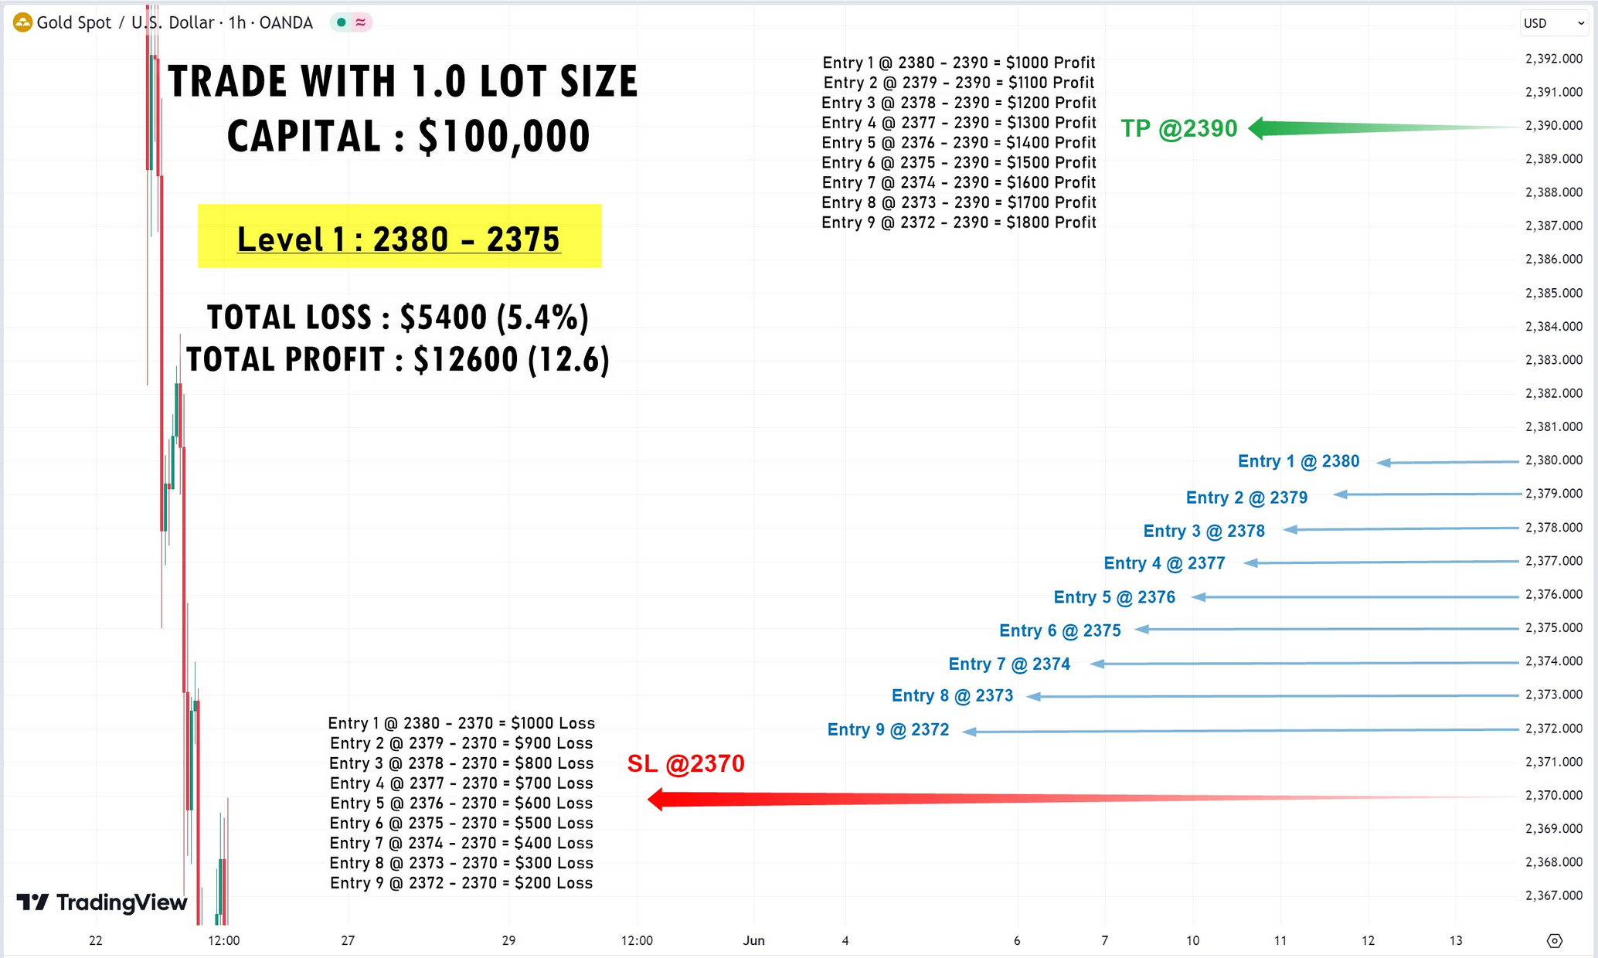

Slide 20
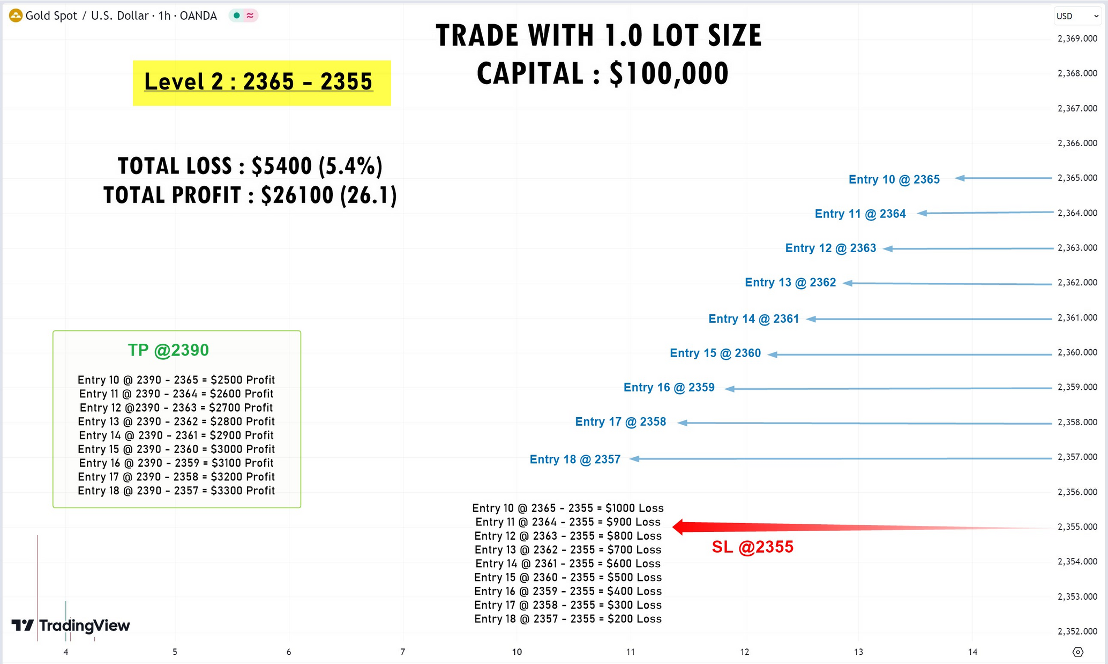

Slide 21
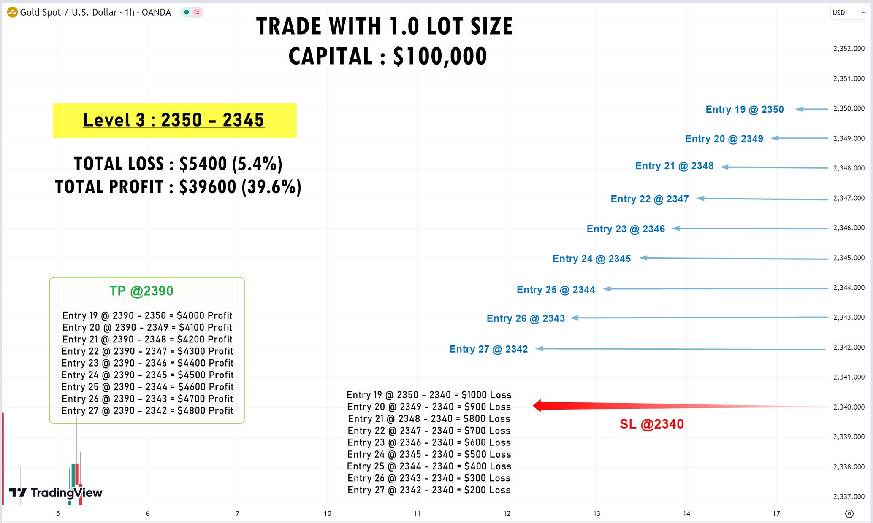

Slide 22
1.0 LOT TRADED
RISK CALCULATION
Level 1 : 2380-2375 | SL - 2370
Level 2 : 2365-2360 | SL - 2355
Level 3 : 2350-2345 | SL - 2340
Entry 2 @ 2379 - 2370 = $900
Loss
Entry 11 @ 2364 - 2355 = $900
Loss
Entry 20 @ 2349 - 2340
= $900
Loss
Entry 1 @ 2380 - 2370 = $1000 Loss
Entry 3 @ 2378 - 2370
= $800
Loss
Entry 10 @ 2365 - 2355 = $1000 Loss
Entry 12 @ 2363 - 2355
= $800
Loss
Entry 19 @ 2350 - 2340
= $1000
Loss
Entry 21 @ 2348 - 2340 = $800
Loss
Entry 4 @ 2377 - 2370
= $700
Loss
Entry 13 @ 2362 - 2355
= $700
Loss
Entry 22 @ 2347 - 2340
= $700
Loss
SL @ 2370
$5400 Loss (Level 1)
ROI = 5.4%
SL @ 2355
$5400 Loss (Level 2)
ROI = 5.4%
SL @ 2340
$5400 Loss (Level 3)
ROI = 5.4%
Entry 5 @ 2376 - 2370 = $600 Loss
Entry 14 @ 2361 - 2355 = $600 Loss
Entry 23 @ 2346 - 2340 = $600 Loss
Entry 6 @ 2375 - 2370 = $500 Loss
Entry 15 @ 2360 - 2355 = $50
Loss
Entry 24 @ 2345 - 2340 = $500 Loss
Entry 9 @ 2372 - 2370 = $200
Loss
Entry 7 @ 2374 - 2370 = $400 Loss
Entry 18 @ 2357 - 2355 = $20
Loss
Entry 16 @ 2359 - 2355 = $40
Loss
Entry 27 @ 2342 - 2340 = $200
Loss
Entry 25 @ 2344 - 2340 = $400 Loss
Entry 8 @ 2373 - 2370 = $300 Loss
Entry 17 @ 2358 - 2355 = $30
Loss
Entry 26 @ 2343 - 2340 = $300 Loss
RISK FORMULA :
=Entry - SL = $__ Profit
RISK = $__ Profit * 100 / CAPITAL
TOTAL $16200 LOSS

Slide 23
1.0 LOT TRADED
REWARD CALCULATION
Level 1 : 2380-2375 | TP - 2390
Level 2 : 2365-2360 | TP - 2390
Level 3 : 2350-2345 | TP - 2390
Entry 2 @ 2390 - 2379 = $1100 Profit
Entry 11 @ 2390 - 2364 =$2600 Profit
Entry 20 @ 2390 - 2349 = $4100 Profit
Entry 3 @ 2390 - 2378
= $1200 Profit
Entry 1 @ 2390 - 2380 = $1000 Profit
Entry 12 @ 2390 - 2363
= $2700 Profit
Entry 10 @ 2390 - 2365 = $2500 Profit
Entry 21 @ 2390 - 2348 = $4200 Profit
Entry 19 @ 2390 - 2350 = $4000 Profit
Entry 4 @ 2390 - 2377 = $1300 Profit
Entry 13 @ 2390 - 2362 = $2800 Profit
Entry 22 @ 2390 - 2347
= $4300 Profit
TP @ 2390
Total $12600 Profit
ROI = 12.6%
TP @ 2390
Total $26100 Profit
ROI = 26.1%
TP @ 2390
Total $39600 Profit
ROI = 39.6%
Entry 5 @ 2390 - 2376
= $1400 Profit
Entry 14 @ 2390 - 2361
= $2900 Profit
Entry 23 @ 2390 - 2346 = $4400 Profit
Entry 6 @ 2390 - 2375
= $1500
Profit
Entry 15 @ 2390 - 2360
= $3000 Profit
Entry 24 @ 2390 - 2345 = $4500
Profit
Entry 7 @ 2390 - 2374 = $1600 Profit
Entry 9 @ 2390 - 2372 = $1800 Profit
Entry 16 @ 2390 - 2359 = $3100 Profit
Entry 18 @ 2390 - 2357 = $3300 Profit
Entry 25 @ 2390 - 2344 = $4600 Profit
Entry 27 @ 2390 - 2342 = $4800 Profit
Entry 8 @ 2390 - 2373 = $1700 Profit
Entry 17 @ 2390 - 2358 = $3200 Profit
Entry 26 @ 2390 - 2343 = $4700 Profit
TOTAL $78300 PROFIT
REWARD FORMULA :
=Entry - TP = $__Profit
Reward = $__Profit * 100 / Capital

Slide 25
CONCLUTION
FOCAL SERVICE
PREMIUM SERVICE
PLATINUM SERVICE
Trading lot size : 0.01 lot
Capital = 1000
Risk to Reward Ratio : 1/1.5
Daily loss : $54
Daily profit : $126
Accuracy : 90%
Trading days : 22
Monthly risk 10%
$54* 3 days = $162
Monthly reward 90%
$126* 19 days = $2394
Trading lot size : 0.10 lot
Capital = 10k
Risk to Reward Ratio : 1/1.5
Daily loss : $1080
Daily profit : $3870
Accuracy : 97%
Trading days : 22
Monthly risk 3%
$1080* 2 days = $2160
Monthly reward 97%
$3870* 20= $77,400
Trading lot size : 1.0 lot
Capital = 100k
Risk to Reward Ratio : 1/1.5
Daily loss : $16200
Daily profit : $78300
Accuracy : 99%
Trading days : 22
Monthly risk 1%
$16200* 1 days = $16200
Monthly reward 99%
$16500* 21 = $7751700

